Slide 1
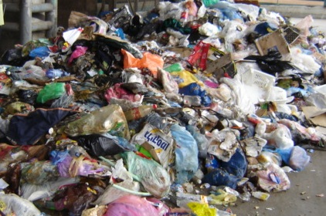

Future of inorganic waste in Texel

Slide 2
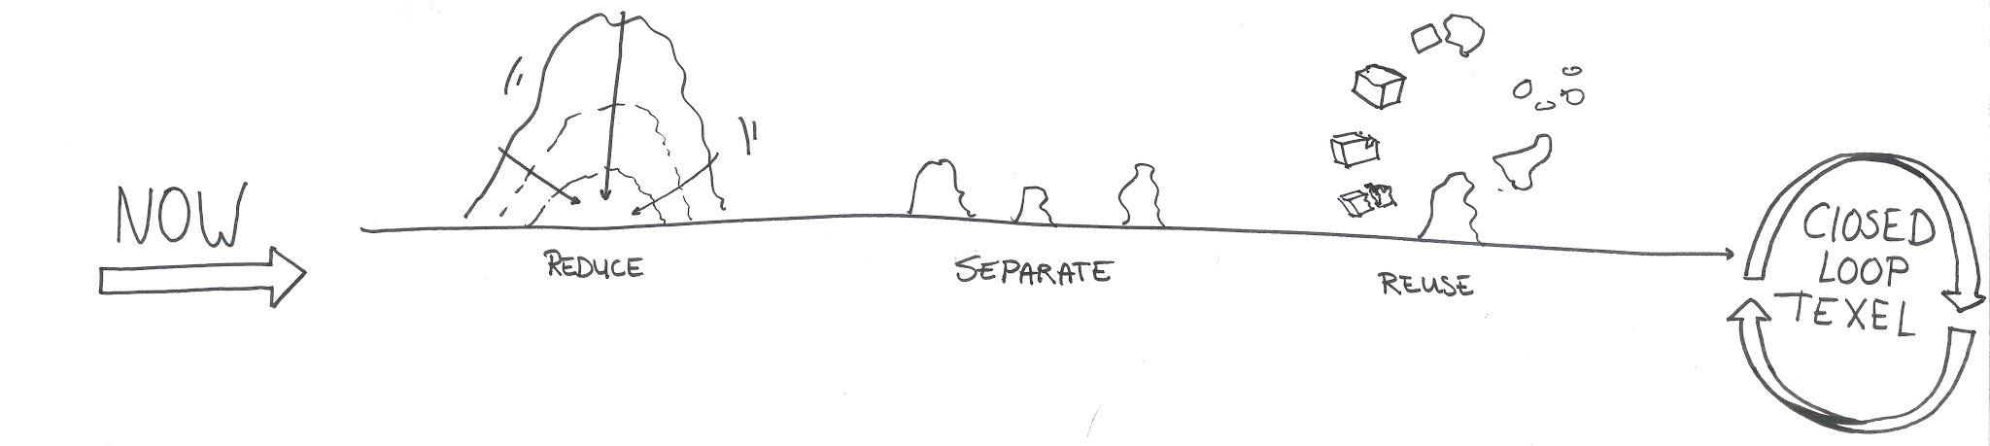
Future of inorganic waste in Texel

Slide 3
Future of inorganic waste in Texel
Package-less stores
Reduce waste competition

Slide 4
Future of inorganic waste in Texel
Collect waste from companies
Show possibilities of what can be done with waste

Slide 5
Future of inorganic waste in Texel
Design competition on what YOU can do with waste
Consider what you bring to the island

Slide 6
Future of inorganic waste in Texel

