Slide 1
Frugal Innovations
October 10th 2016
Matthijs Tichem Ricardo van der Zijden
Thomas Grolleman Roos de Brouwer
Ramin Shirzad

Slide 2

Today’s objectives
Understand the concept of frugal innovation.
What is it?
Opportunities & challenges?
How can we apply frugal innovation in our SPG’s.

Slide 3
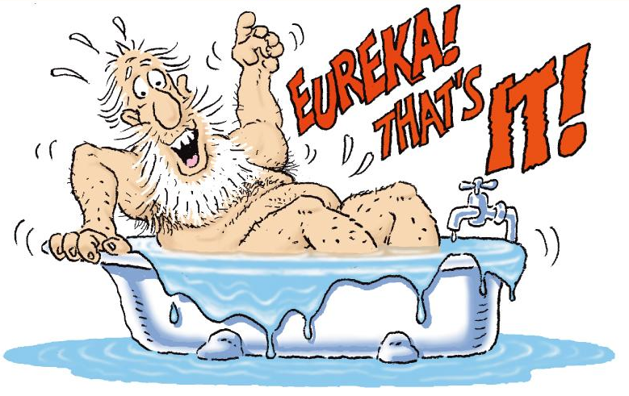
Innovation
What is it ?

Slide 4
Innovation = Renewal
The development and implementation of new and improved techniques, products and production processes.
! Also, the implementation of existing techniques, products and processes in an area where this has not been applied!

Slide 5

What is Frugal Innovation?
What is it ?

Slide 6
What is Frugal Innovation?
“Innovation with reduced complexity & cost”
Focus on the Bottom of the Pyramid (BoP).
While maintaining a high level of quality.
How? By stripping down/ re-engineering existing products or create new effective, yet cheap products that originate from consumer demand..

Slide 7

What is Frugal Innovation?
“innovation with reduced complexity & cost”
Focus on the Bottom of the Pyramid (BoP).
Maintain a high level of quality.
Is this a definitive
definition...

Slide 8
What is Frugal Innovation?
“innovation with reduced complexity & cost”
Focus on the Bottom of the Pyramid (BoP).
Maintain a high level of quality.
“Do more with less”
Business perspective
! Not the only factor that determines if an innovation is frugal !

Slide 9
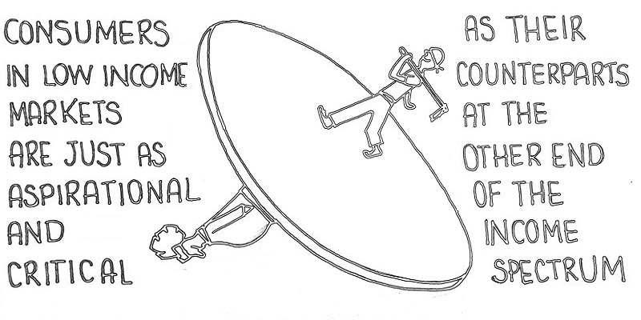


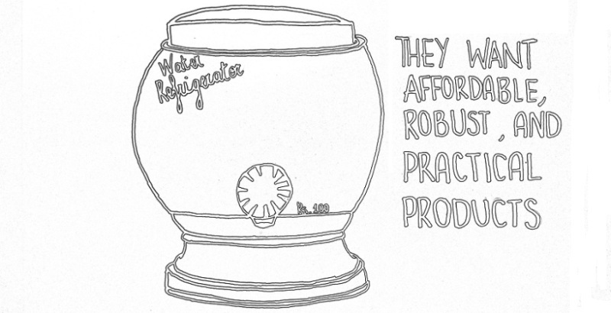
Frugal Innovation
Financial Accessible
Standards
Responsible
Social Oriented
Together

Slide 10
TAHMO weather stations
Self-sustaining observation network of weather/water management stations.
Make Africa the best monitored continent.
Monitor how much rain will fall and the distribution of drop sizes.
Low construction cost.
Robust station → hardly any maintenance.
Target audience: Farmers/ researchers/ insurance companies.
Located at schools; protection and providing educational material.
Financed by public-private partnerships.
Is it a frugal innovation?

Slide 11
Quiz
Waka Waka lamp
Tata Nano
Microcredit
E-waste 3D printer
https://play.kahoot.it/#/k/e2068d83-a65d-4910-a026-845612c18e61

Slide 12
Grameen bank

Slide 13
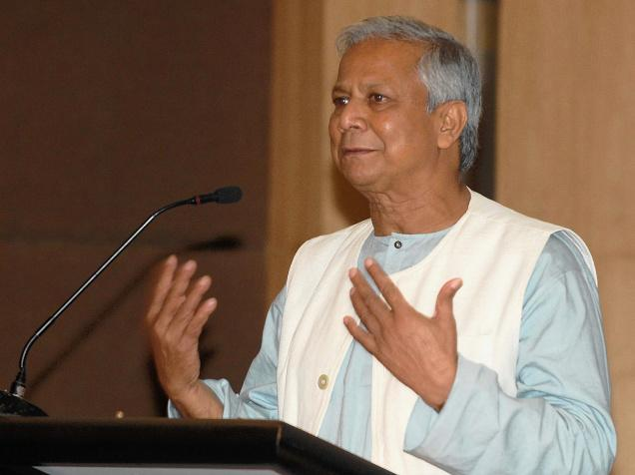
Muhammad Yunus

Slide 14
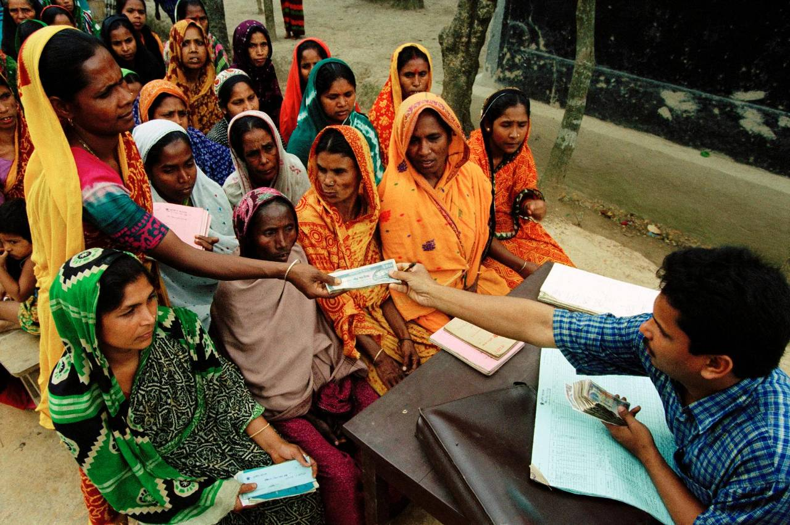
Microcredit
Frugal innovation
Grameen Bank
Muhammad Yunus

Slide 15
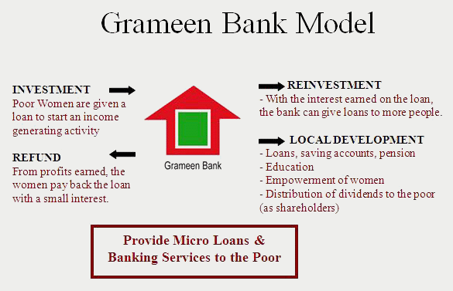

Slide 16
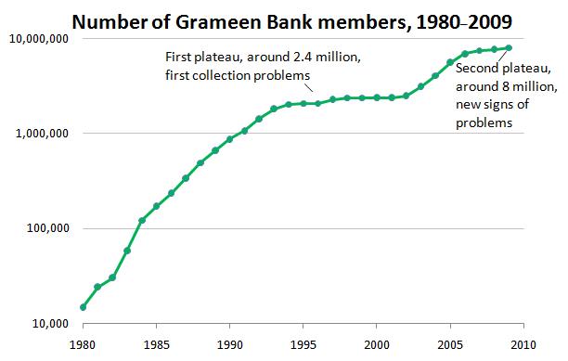

Slide 17
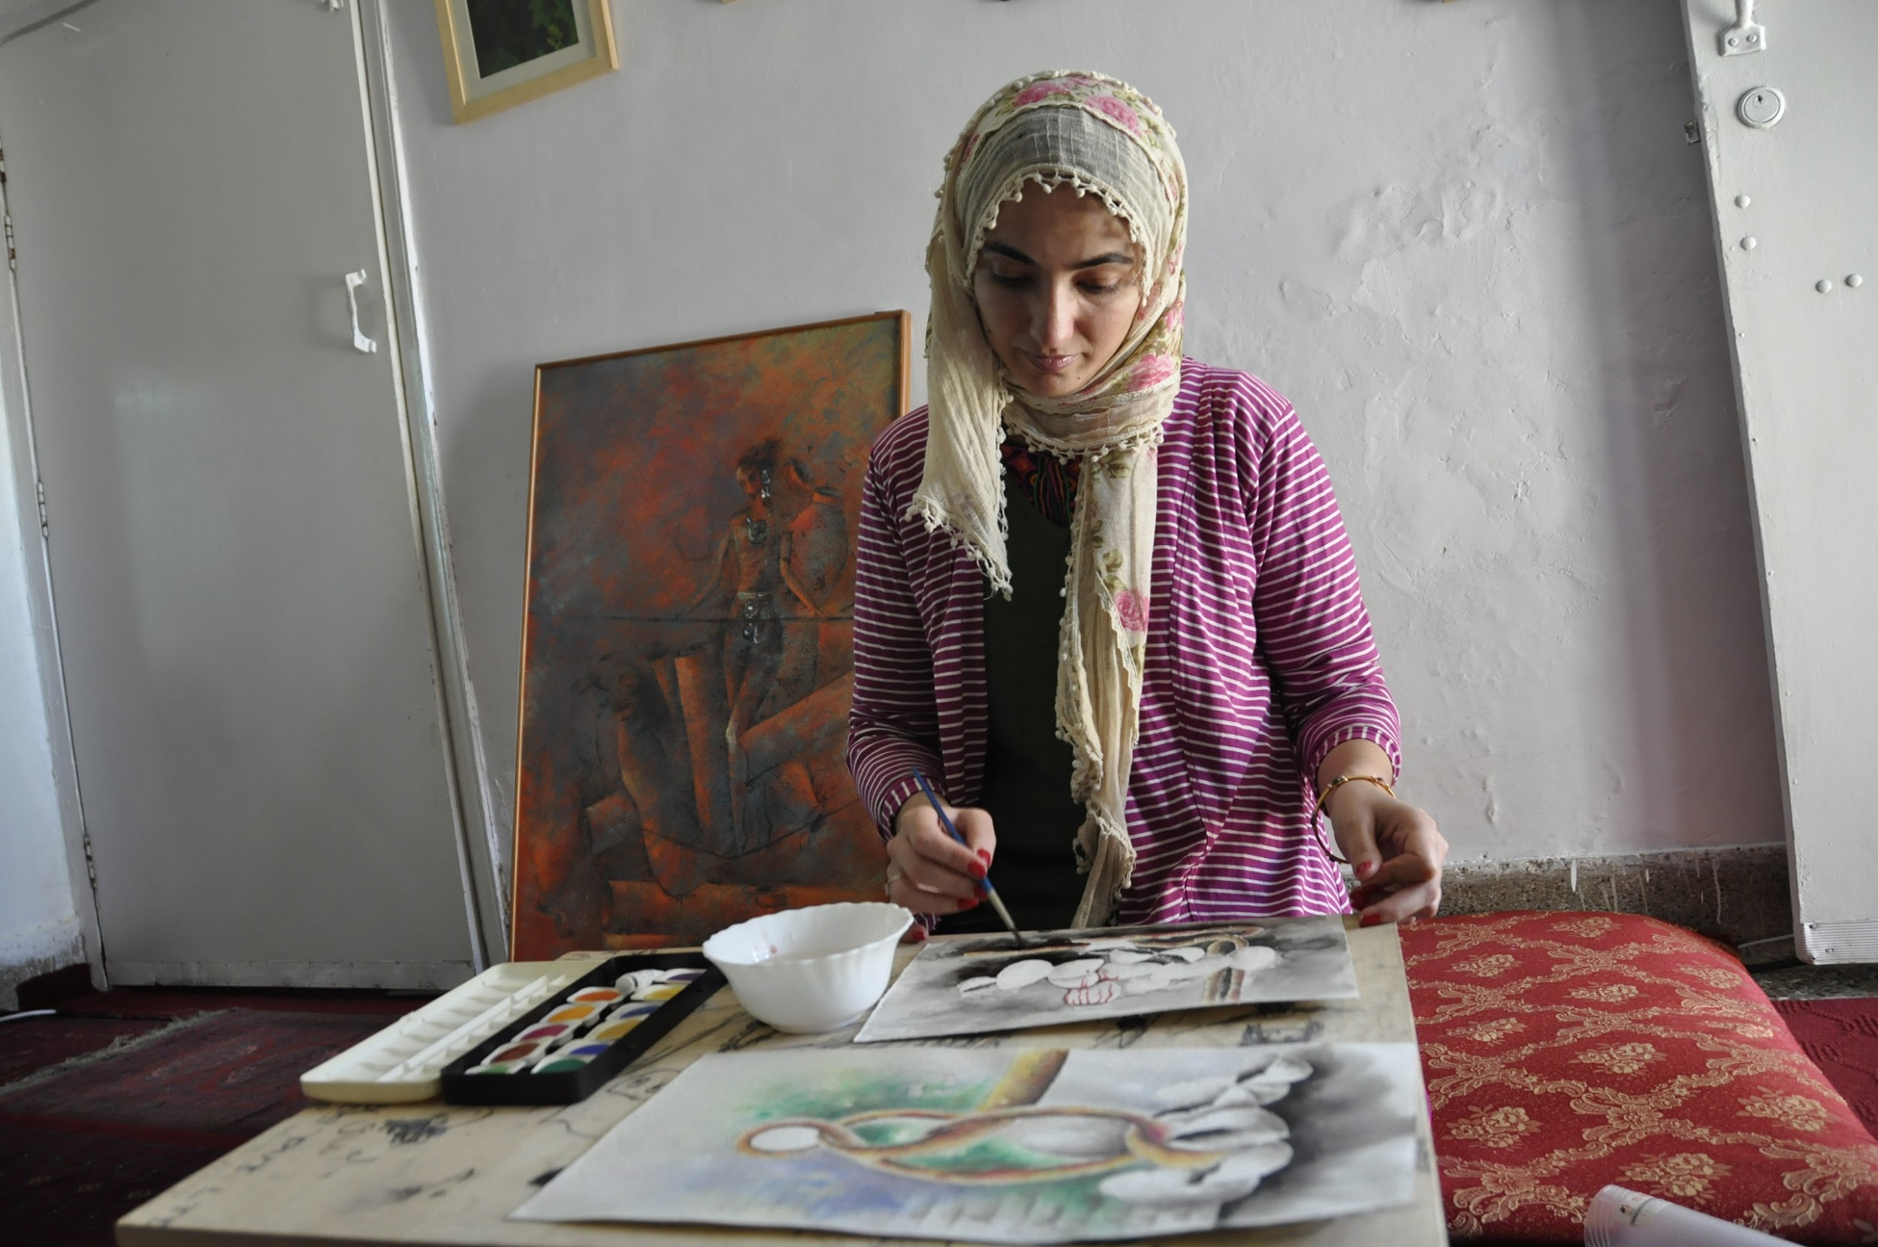

Slide 18
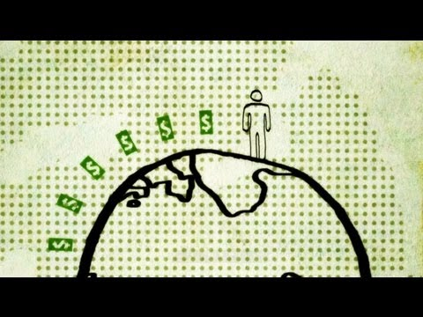
Why is this a frugal innovation?

Slide 19
Local Exchange Trading System

Slide 20
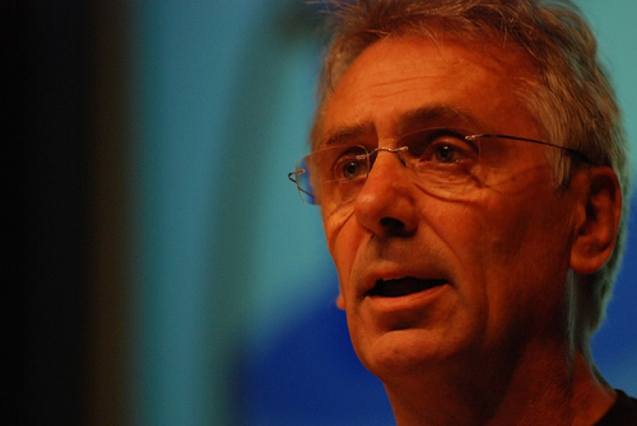
Michael Linton

Slide 21
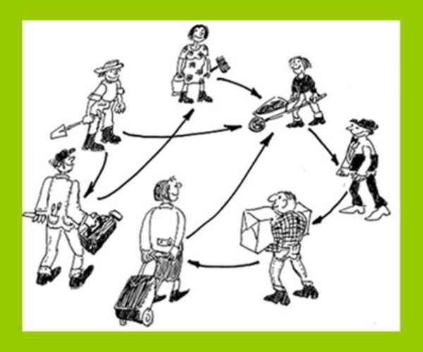

Slide 22
Criteria
Cost of service
Consent
Disclosure
Equivalence to the national currency
No interest

Slide 23

Noppes
Dutch exchange system for goods and services
Participants pay with noppes

Slide 24
Why is this a frugal innovation?

Slide 25
Interaction
Please settle in the SPG groups

Slide 26
Design frugal innovations
3 rounds for designing frugal innovations:
  Technical frugal innovation
  Ecological frugal innovation
  Social frugal innovation
Specific frugal innovations for your problem in your SPG city
Detailed as possible:
  Describe
  Creative
  Draw

Slide 27
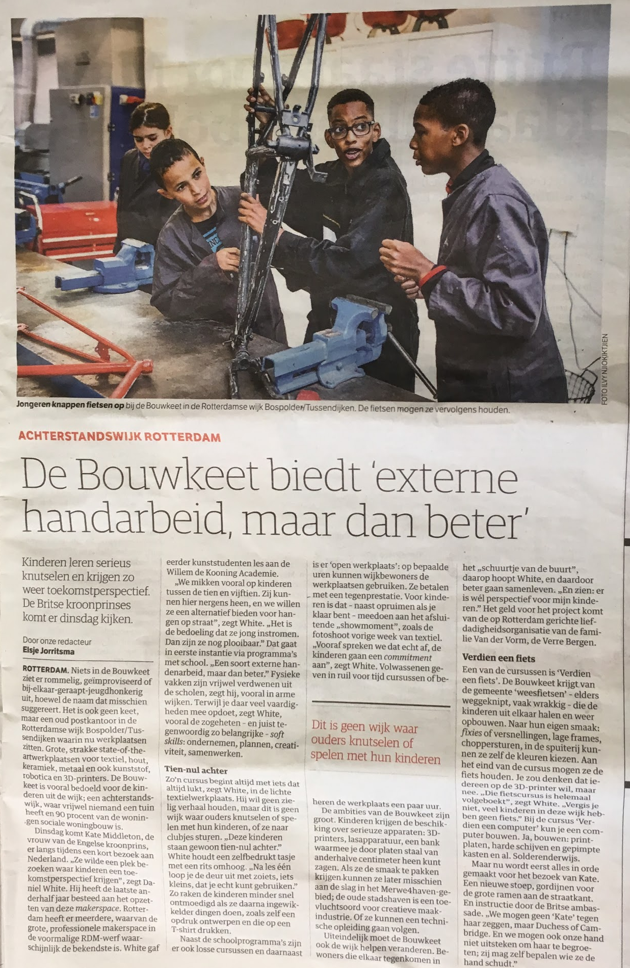

Slide 28
Technical frugal innovation - 15 minutes
“Design a technical frugal innovation which helps your city to solve the main problem of your project”

Slide 29
Ecological frugal innovation - 15 minutes
“Design a ecological frugal innovation which helps your city to solve the main problem of your project”

Slide 30
Social frugal innovation - 15 minutes
“Design a social frugal innovation which helps your city to solve the main problem of your project”

Slide 31
Feedback - 15 minutes
“Present the frugal innovations to each other in the assigned groups. Please give constructive feedback to the other group.”

