Slide 1
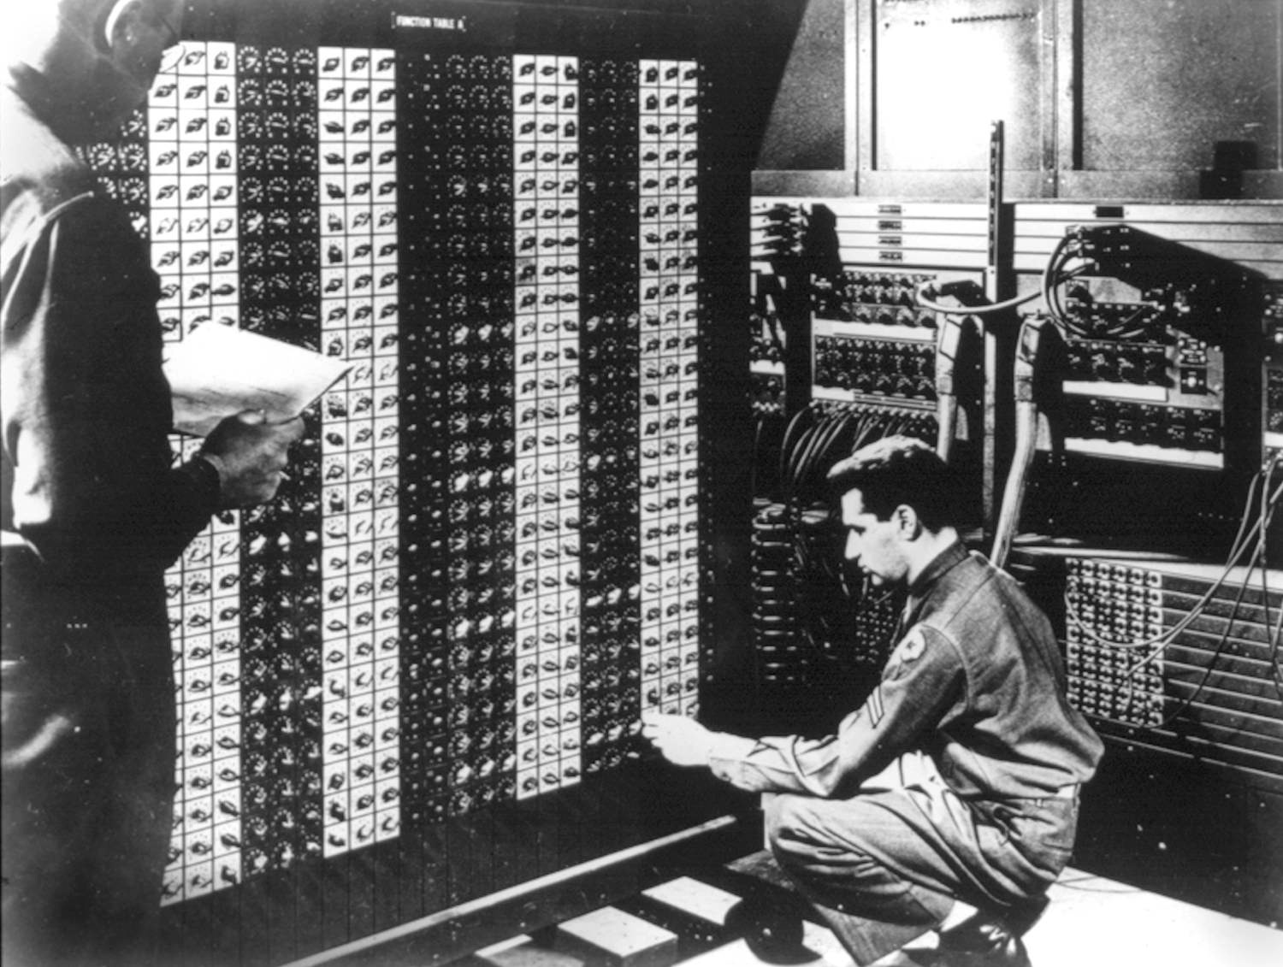
Dealing with uncertain future
Introduction to Innovation
Berend van Veldhuizen

Slide 2
Unknown
unknowns

Slide 3
Collingridge Dilemma
Technology is development -> effects are hard to predict
Technology implemented
-> hard to make changes

Slide 4
Approach to Collingridge dillema
Anticipation on risk
$$Risk=probability∙effect$$
Uncertainty & ignorance
Precautionary principle
Threats -> measures
Incoherent & ignorance

Slide 5
Alternative Approach
Social experiment

Slide 6
What makes technology responsible?
Absence of alternatives
Controllability
Informed consent
Proportionality of risks and benefits

Slide 7
Case Study
Risk estamation
Monitoring
Labelling
Continuity

